Slide 1


PROJECT- THE ECOMMERCE FASHION INDUSTRY
Aiming at fashion industry to keep up with the trends and helps to grow its online fashion business.
Project: P102
Team Name: Group-4
Presenter: Mr. Rahul Kumar Singh
Mr. R vamsi Sai Kumar reddy
Mr. Vishal Vijay Kakade
Mr. R. Hari Haran
Mr. Mummareddy Manikumara Swamy
Mr. Sushilkumar Yadav
Mentor : Mr. Rajashekar
Date: 14th April 2022

Slide 2
TABLE OF CONTENTS
01
02
03
Business Understanding
Data Understanding
Data Preparation
The Data Business Objective
Import Libraries Load Data Statistical summaries and visualisations
Exploratory Data Analysis Data Splitting
04
05
06
Modeling
Deployment
Conclusion & Recommendation
Technique with Standard Scaler, Technique by adjusting outliers & Standard Scaler, Technique by adjusting outliers & Log Transformation
Finalizing Model Choice, Model performance, Feature importance
Click Here to get Github Link for the python file.

Slide 3


Business Understanding
01

Slide 4
The Data
What is Ecommerce?
Ecommerce, also known as electronic commerce or internet commerce, refers to the buying and selling of goods or services using the internet, and the transfer of money and data to execute these transactions. Ecommerce is often used to refer to the sale of physical products online, but it can also describe any kind of commercial transaction that is facilitated through the internet.
Types Of Ecommerce
Business to Consumer (B2C)
Business to Business (B2B)
Direct to Consumer (D2C)
Consumer to Consumer (C2C)
Consumer to Business (C2B)

Slide 5
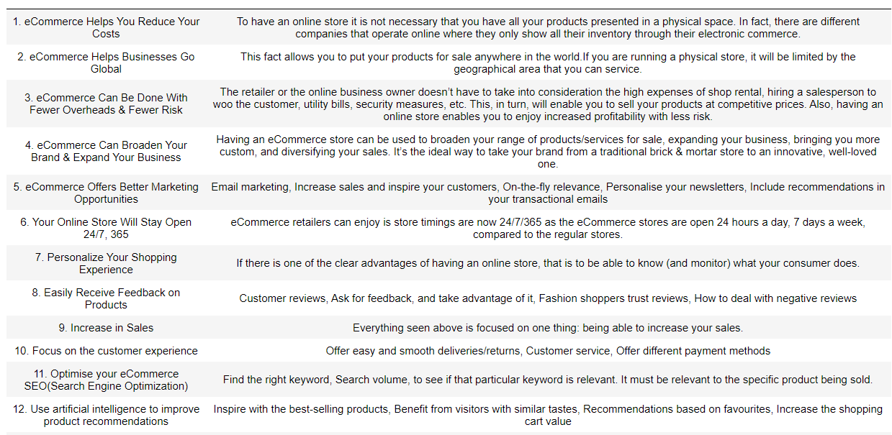
The Data (Cont’d)
The Importance of Ecommerce

Slide 6
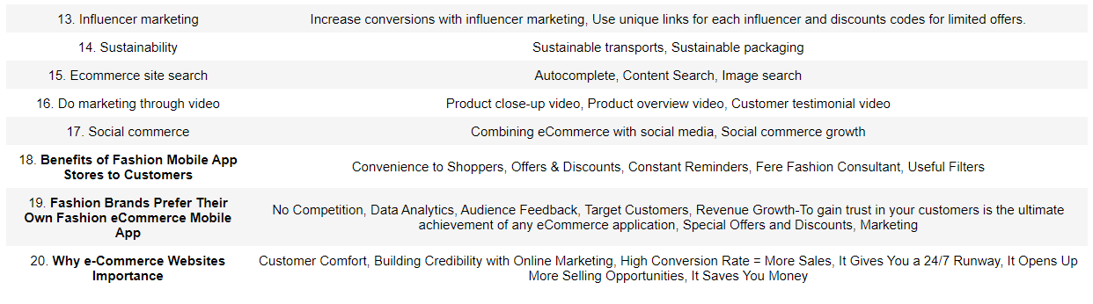
The Data (Cont’d)
The Importance of Ecommerce

Slide 7
Business Problem
This dataset includes description of an Ecommerce company based in London sells clothing online but they also have in-store style and clothing advice sessions. Customers come in to the store, have sessions/meetings with a personal stylist, then they can go home and order either on a mobile app or website for the clothes they want. The company is trying to decide whether to focus their efforts on their mobile app experience or their website. They've asked to help them figure it out.
Summary: We worked with the Ecommerce company and the dataset name is Ecommerce.csv. It has Customer info, such as Customer ID, Avg Session length, Time on App, Time on Website, Length of MemberShip, Yealy amount spent.
Attribute Information:
Customer ID: A unique identification number given to every Customer.
Avg Session length: Customers come in to the store, have sessions/meetings with a personal stylist.
Time on App: Time spent by customer on company mobile app.
Time on Website: Time spent by customer on website.
Length of Membership: The number of years/months in a membership term by customer.
Yearly amount spent: Amount yearly spent by customer in an ecommerce shopping with the company.

Slide 8

Business Objective
Company Business Problem: The company is trying to decide whether to focus their efforts on their mobile app experience or their website. Interpret which variables are contributing towards the more annual income prediction.
Objective: The objective of the analysis is to predict Feature Importance. Feature importance refers to techniques that assign a score to input features based on how useful they are at predicting a target variable. Our overall goal is to use the Ecommerce dataset shown below to develop a machine learning model that attempts to predict which variables is contributing towards the more annual income, so that company can maintain its budget by investing more in that, to gain more revenue and its helps to groom its online business.

Slide 9

Data Understanding
02

Slide 10
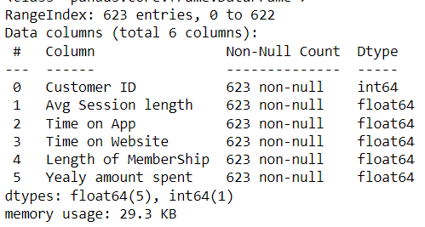
Data Understanding
The Ecommerce company dataset consisted of: 623 entries and 6 columns.
There are attributes:
1. Customer ID: A unique identification number given to every Customer.
2. Avg Session length: Customers come in to the store, have sessions/meetings with a personal stylist.
3. Time on App: Time spent by customer on company mobile app.
4. Time on Website: Time spent by customer on website.
5. Length of Membership: The number of years/months in a membership term by customer.
6. Yearly amount spent: Amount yearly spent by customer in an ecommerce shopping with the company.
Most of them in our dataset are “float64”, but Customer ID is in “int64”.

Slide 11
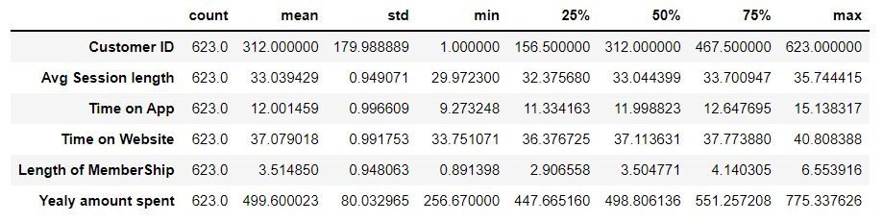
Data Understanding (Cont’d)
1. The minimum timing that a customer spend at the store is 30 min and the
maximum is 35 min.
2. The minimum average time spent on mobile app is 9 min and the maximum is
15 min.
3. Time spent on website mean is 37 min that is much more than that of App.
4. The std shows that data are less dispersed in relation to the mean. The max
increase in yearly amount spent shows that the data is not normally distributed,
there is skewness in the dataset.

Slide 12
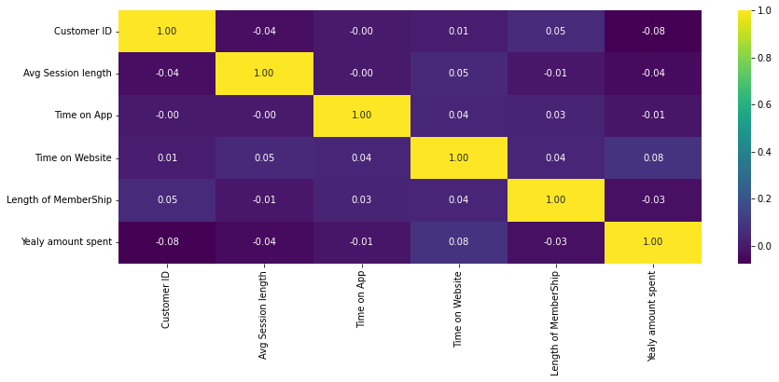
Data Understanding (Cont’d)
Inference from ‘r’ values and heatmap
No 2 factors have strong linear relationships
Avg Session length, Time on App, Length of Membership are all negatively correlated with Yearly amount spent. Have moderate negative relationship.
Only Time on Website is positively related with all others variables.
‘Customer ID' is uniformly distributed and there is no correlation with other variable.

Slide 13

Exploratory Data Analysis & Data Preparation
03

Slide 14
Exploratory Data Analysis & Data Preparation
We will be removing the 'Customer ID' as doesn't make any sense with the company growth, its just an ID given to customer to locate in the company database. 'Customer ID' is an irrelevant columns to our dataset. Irrelevant features can decrease the accuracy of the model.
There are null duplicate values in the dataset
We can see that we do not have missing values in the respective columns.
After removing the 'Customer ID' we are left with 5 variables.
As per our Company Business Problem or Business objective: The company is trying to decide whether to focus their efforts on their mobile app experience or their website. Interpret which variables are contributing towards the more annual income prediction.
So if we want to derive the company annual income that will depend on how much your customer spent in your company on your product that is how much customer purchases and leads to company income.
So, 'Yearly amount spent' by customer will be our target variable.

Slide 15
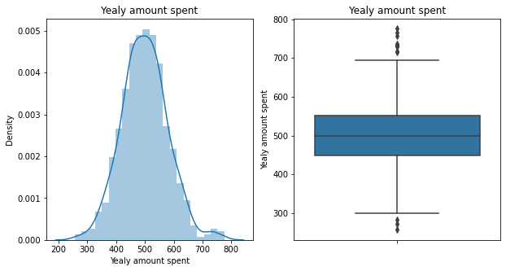
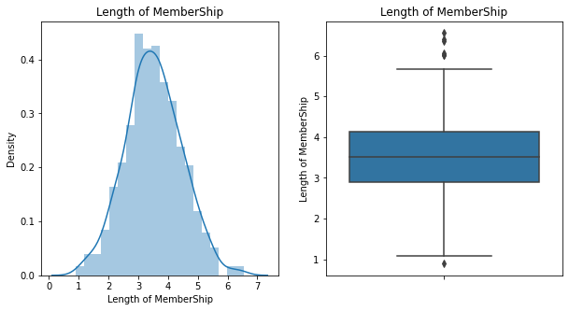
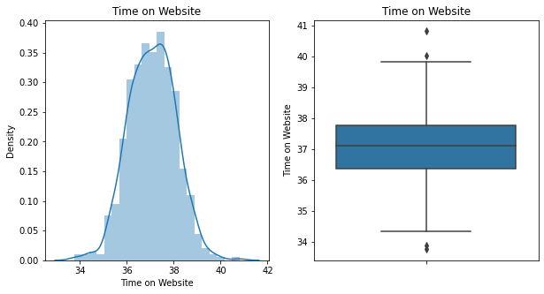
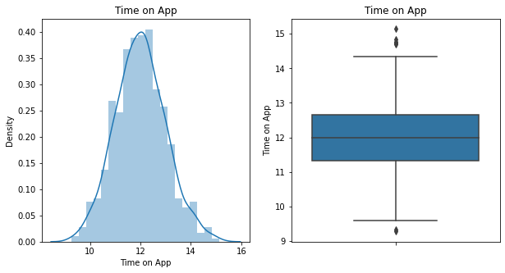
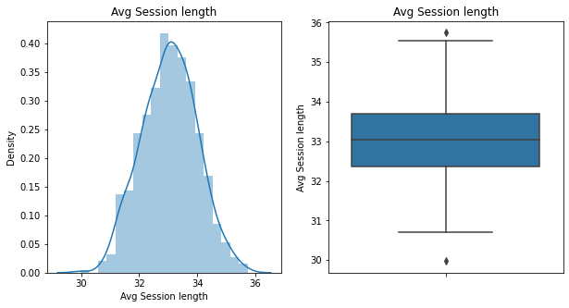
Exploratory Data Analysis & Data Preparation (Cont’d)
Inference:
1. In the Distplot and Box Plot visualization,
(Left-distplot) all the variables are normally distributed, and there are little skewness in the dataset.
2. For the (Right-Boxplot) we can see ‘Yearly amount spent ' & 'Length of Membership' consists lot of outliers present below the minimum and the maximum. These outliers value needs to be treated and there are several ways of treating them.

Slide 16
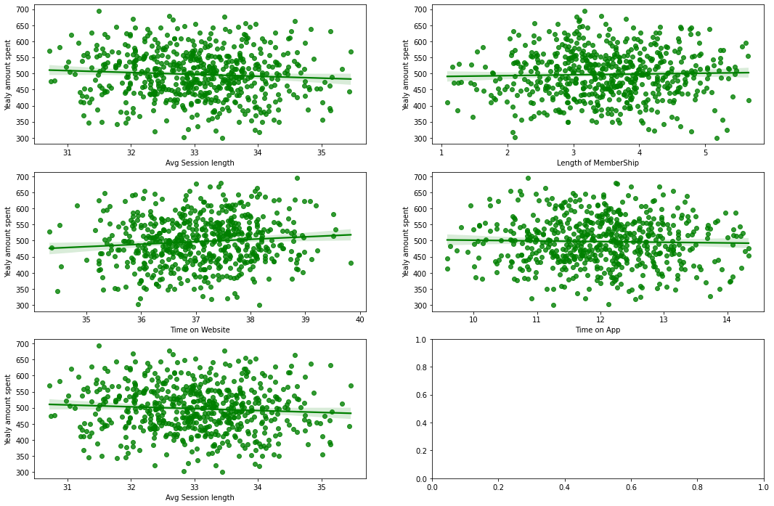
Exploratory Data Analysis & Data Preparation (Cont’d)
Inference from Regplot
From above regplot, we have compare each variables with the target variable. Only 'Time on Website' is giving positive response as it increases. 'Length of Membership' is uniform to our target variable. Rest all other variables are showing negative relation with target variable.

Slide 17
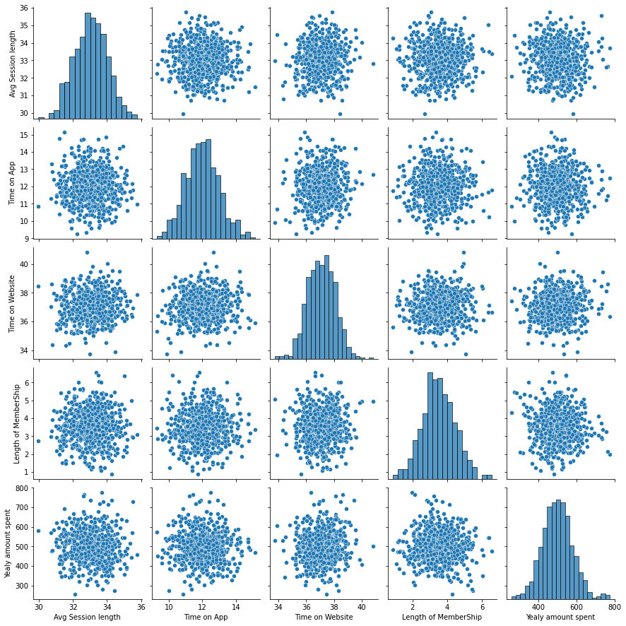
Exploratory Data Analysis & Data Preparation (Cont’d)
Inference from Pair Plots
From scatter plots, we can see there is no positive nor negative linear relationships between the variable.
For distribution all are normally distributed.

Slide 18
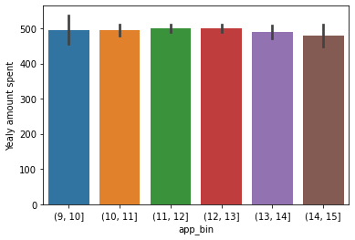
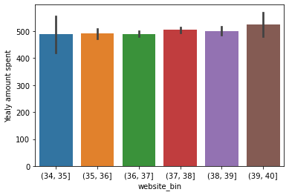
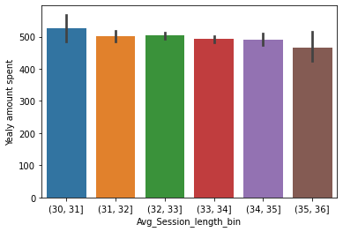
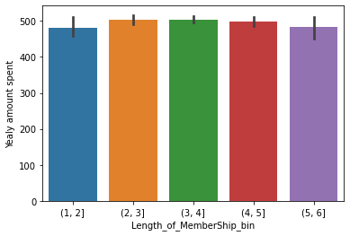
Exploratory Data Analysis & Data Preparation (Cont’d)
Inference from Bin Size
As the time on app is increasing, the amount spent by customer is decreasing and the Time on website is increasing, the customer is also spending more. This shows that company website is generating more revenue than the app.

Slide 19
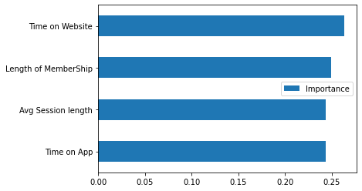
Exploratory Data Analysis & Data Preparation (Cont’d)
Inference from EDA
The most important feature is ‘Time on Website’ and is bringing the most income for the company.

Slide 20
Final Inference before model building
Most of the variables are negatively correlated with each other.
While visualizing bar plot we have seen time has been a very important part of company annual income. How variables are distinguish on time basis on different platform, and how they are influencing the company.
Only Time on Website is positively related with all others variables.
The dataset is normally distributed.
3 Essential Ways to Calculate Feature Importance
Feature importance refers to a class of techniques for assigning scores to input features to a predictive model that indicates the relative importance of each feature when making a prediction.
Method #1 — Obtain importance from coefficients
Method #2 — Obtain importance from a tree-based model
Method #3 — Obtain importance from PCA loading scores
Following are the algorithms we will use to make the model, we will predict on MAE error and feature importance will be obtain from coefficients:
Model1: Modeling with the linear model and tree based model technique with Standard scaler.
Model2: Modeling with the linear and tree based model technique by adjusting outliers & Standard Scaler.
Model3: Modeling with the linear and tree based model technique by adjusting outliers and Log transformation.

Slide 21

04
Modeling

Slide 22
Model1: Modeling with the linear model and tree based model technique with Standard Scaler.
Machine Learning Algorithms | MAE_test | MAE_train | RMSE_test | RMSE_train
ElasticNetCV | 59.952889 | 62.929532 | 73.391327 | 80.591725
Lasso | 60.056694 | 62.884589 | 73.460515 | 80.592627
SGDRegressor | 60.346124 | 62.888902 | 73.873474 | 80.567796
Ridge | 60.382623 | 62.892897 | 73.847466 | 80.565753
LinearRegression | 60.387280 | 62.892734 | 73.852772 | 80.565750
RANSACRegressor | 64.131350 | 66.567162 | 77.950472 | 85.977510
RandomForestRegressor | 64.743648 | 24.805587 | 80.721044 | 31.548412
GradientBoostingRegressor | 66.633154 | 46.881696 | 81.296795 | 58.732336
XGBRegressor | 73.923755 | 3.598124 | 91.560844 | 5.307714
DecisionTreeRegressor | 93.214444 | 0.000000 | 116.369231 | 0.000000
Support Vector Machine | 178.466786 | 20.262132 | 359.430429 | 47.506704

Slide 23
Model2: Modeling with the linear model and tree based model technique by adjusting outliers & Standard Scaler.
Machine Learning Algorithms | MAE_test | MAE_train | RMSE_test | RMSE_train
ElasticNetCV | 57.894676 | 56.021045 | 70.979575 | 69.775019
Lasso | 57.998992 | 56.033917 | 71.059138 | 69.771650
SGDRegressor | 58.486897 | 56.039181 | 71.428782 | 69.740419
Ridge | 58.600759 | 56.011209 | 71.499720 | 69.736030
LinearRegression | 58.608406 | 56.011413 | 71.505865 | 69.736025
RANSACRegressor | 60.168907 | 57.847583 | 73.603523 | 72.481027
RandomForestRegressor | 60.276653 | 21.934144 | 75.076358 | 27.363425
GradientBoostingRegressor | 61.294099 | 40.873862 | 75.542765 | 51.080419
XGBRegressor | 67.069479 | 2.657398 | 83.481700 | 3.982916
DecisionTreeRegressor | 91.248885 | 0.000000 | 110.886278 | 0.000000
Support Vector Machine | 153.153476 | 17.012783 | 270.874735 | 38.951785

Slide 24
Model3: Modeling with the linear model and tree based model technique by adjusting outliers & Log Transformation.
Machine Learning Algorithms | MAE_test | MAE_train | RMSE_test | RMSE_train
Lasso | 55.656024 | 56.790578 | 69.401575 | 70.795188
Ridge | 55.990553 | 56.484913 | 69.507574 | 70.434065
SGDRegressor | 56.090926 | 56.464063 | 69.567868 | 70.698717
ElasticNetCV | 56.126915 | 56.357889 | 69.608213 | 70.121113
LinearRegression | 56.428149 | 56.312395 | 69.765433 | 70.084448
Support Vector Machine | 56.870750 | 53.921253 | 70.230494 | 68.644976
RandomForestRegressor | 58.882330 | 22.086312 | 72.972487 | 27.897124
GradientBoostingRegressor | 61.415418 | 38.438838 | 74.803730 | 48.835506
RANSACRegressor | 62.836561 | 61.503014 | 78.413929 | 76.383956
XGBRegressor | 65.281752 | 2.022084 | 80.488135 | 2.984857
DecisionTreeRegressor | 83.575328 | 0.000000 | 103.185323 | 0.000000

Slide 25
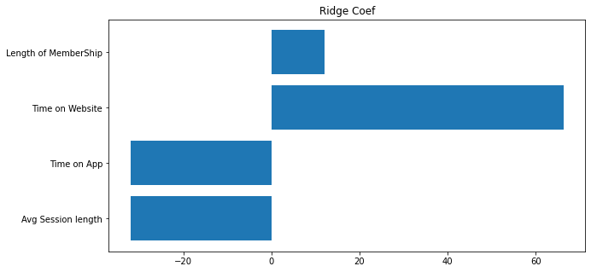
Modeling: Finalizing Model & Coefficients Visualization
From all the three model metrics, we came up that lasso is giving us the least MAE error although we cannot use Lasso, as coefficients for features are not available. But we can use Ridge as we can get all the coefficients importance for all the variables.
Final Hold Out Test Performance for Reporting
Machine Learning Algorithms | Test MAE | Train MAE | Test RMSE | Train RMSE
Ridge | 55.990552 | 56.484912 | 69.507574 | 70.434064

Slide 26


Model Deployment
05

Slide 27
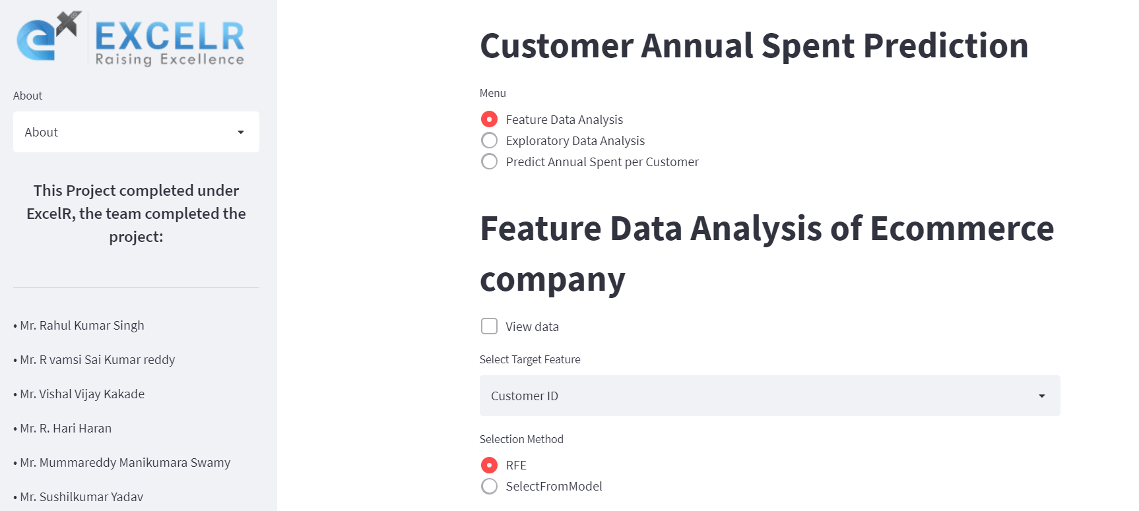
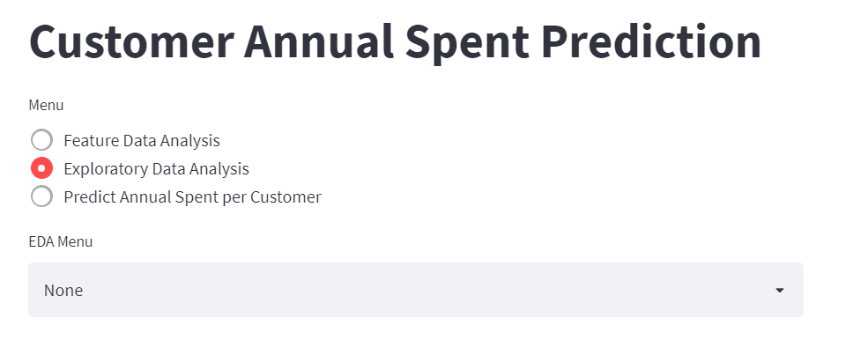

Model Deployment With Streamlit
Click hear to visit the app

Slide 28

Conclusion & Recommendation
06

Slide 29
Conclusion & Recommendation
Both models and our data analysis shows that 'Website' generates more sales than 'Mobile App'. So company should focus there budget on website to make it more suitable for the customer.
To increase the company sale from mobile app company should try to make discount chart, if customer order more product from company app than more discount be allowed.
While doing EDA, we have seen 'Length of Membership' and ‘Yearly amount spent' is showing uniformity. Company has to see, how to increase customer spending although they are loyal customer but company has to find a way like giving them extra discount or pre sale entry to increase there spending with the company.
Although our dataset is too small which makes difficult for prediction and MAE & RMSE will be high this can be removed if more data is included in the dataset.
Lastly, So as Time on Website is a much more significant factor than Time on App, the company has a choice: they could either focus all the attention into the Website as that is what is bringing the most money in, or they could focus on the App as it is performing so poorly! I would recommend company to spent more on website and make it more smooth but also increase the user exp. on mobile app as well.

Slide 30

Thanks!
Any questions? You can find us at:
rahulsingh409@gmail.com
dhamudamodhar@gmail.com
infovishkakade@gmail.com
hariawesome8@gmail.com
manikumar.mh@gmail.com
2sushilkumaryadav@gmail.com

